Slide 1

Menu System
By Sanjay and Arvind Seshan

Slide 2
Lesson Objectives
Learn to use variables
Learn to create a menu system that is not limited to a particular number of choices
Learn to create a menu system that updates the menu view
Prerequisites: Variables, Math Blocks, Brick Buttons

Slide 3
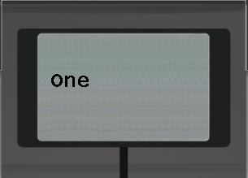
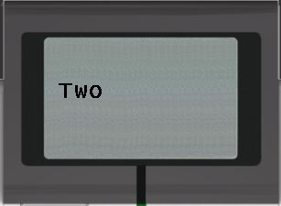
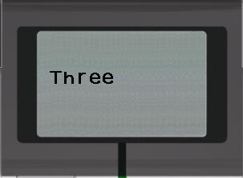
A Fancier Menu System
In the “Using Brick Buttons as Sensors” Lesson in Intermediate, one of the challenges asked you to create a menu with 4 choices and a single screen display for the entire menu
In this version, we build a menu system that updates the menu view each time you change your selection and lets you have a larger number of menu choices
To make this menu, you will need to learn how to use variables

Slide 4
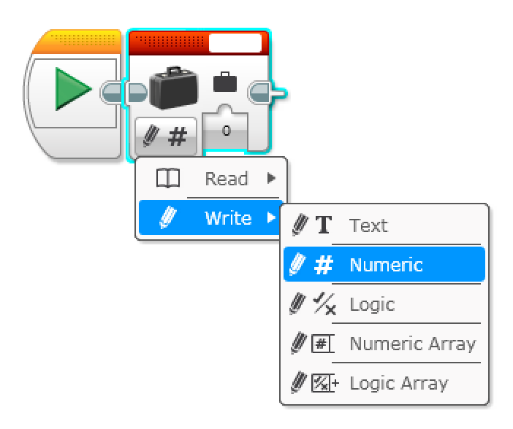
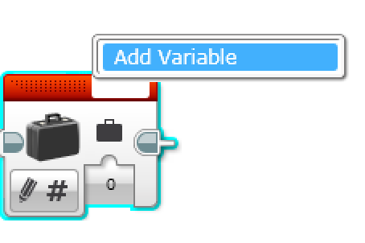
Review: Variables Lessons
A. Variables can store values for later use
B. There are different types of variables. You must chose the type of variable before creating one.
C. You must create a variable and give it a name before using it.
D. Once created, you can read and write values to the variable.
In this lesson, we use numeric variables.

Slide 5
Menu Challenge
Challenge: Make a menu system that lets you perform 3 actions (display and say the numbers 1, 2, and 3) based on the button pressed
Step 1: Use a variable to store the current menu choice
Step 2: Display the menu description for the current menu choice
Step 3: Wait for the user to press a button (top, middle, down buttons)
Step 4: Based on the button press: run the code for the menu choice (for middle button), or increase/decrease the menu choice variable (for up/down buttons)
Step 5: Go back to 2…
What you will see on the EV3 Brick

Slide 6
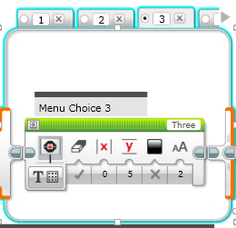
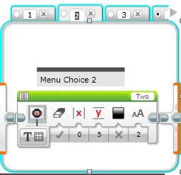
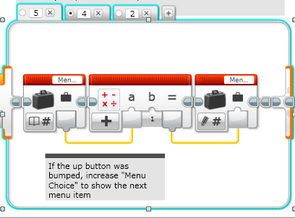
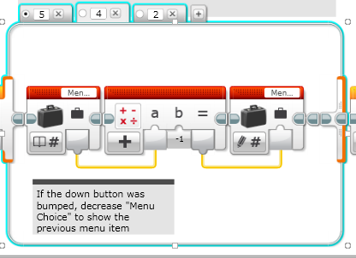
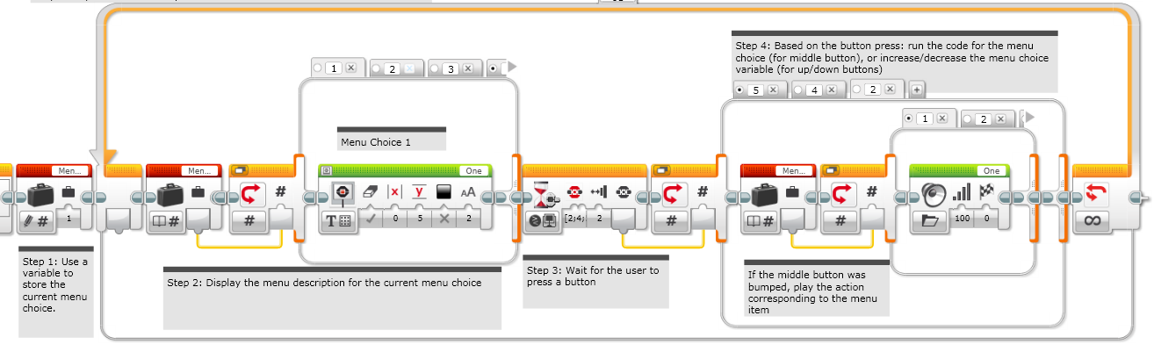
Challenge Solution

Slide 7
Next Steps
The ideas in this lesson can be adapted to help you build a mission sequencer for FLL. Sequencers are useful because they:
  Allow you to skip missions if you are short of time
  Allow you to repeat failed missions
  Allow you access missions quickly (find them easily)
If your Menu Action code is long (not just a display and sound), consider creating My Blocks out of your code

Slide 8
Credits
This tutorial was created by Sanjay Seshan and Arvind Seshan
More lessons at www.ev3lessons.com
This work is licensed under a Creative Commons Attribution-NonCommercial-ShareAlike 4.0 International License.

