Slide 1
PixyCam for MINDSTORMS
Color Identifinder

Slide 2
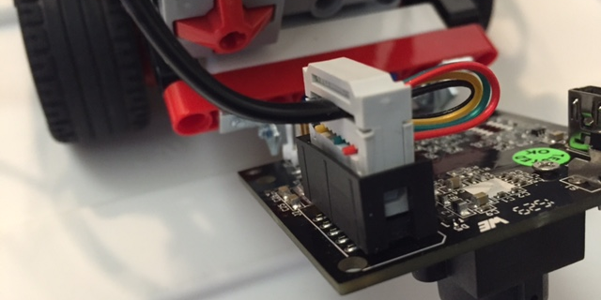
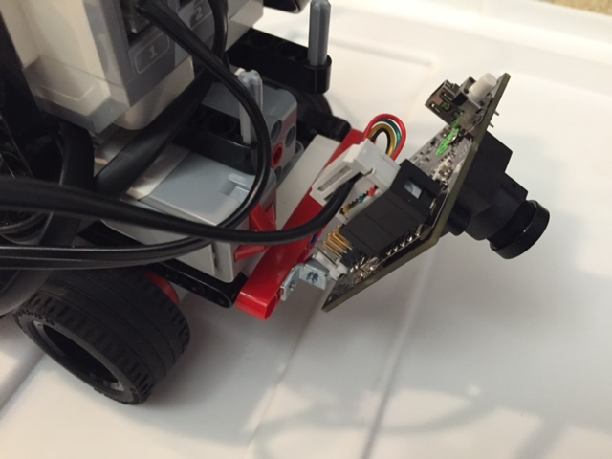
Getting Started
Make sure you have done the PixyCam Introduction lesson, have signatures for red, green, blue, and yellow LEGO blocks, and have installed the PixyCam EV3 blocks
Use the instructions on Mounting Pixy with LEGO to mount a LEGO piece on to the camera
Use additional LEGO pieces to connect your PixyCam to your robot wherever you decide
Use the wire provided to plug in your PixyCam to your robot in port 1

Slide 3
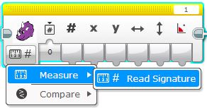
Learning the PixyCam Block
Pixy Camera block
  It is located in the yellow programming tab
  We will be using it in Measure – Read Signature mode
  We will be using the Signature Output which outputs which signature the camera detects
Signature output

Slide 4
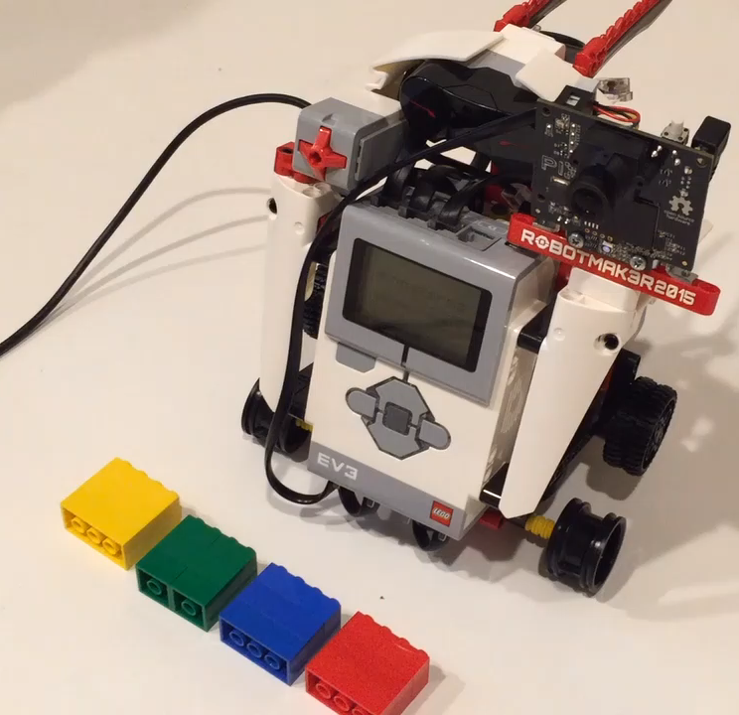
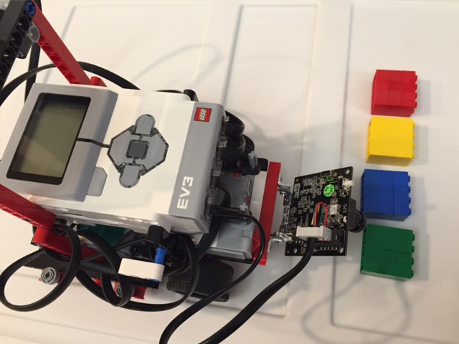
Challenge
Watch Solution Video
Use your PixyCam to have your EV3 recognize 4 different LEGO bricks (Red, Green, Blue, Yellow) and say which color it is
Every time you show the PixyCam a different color, the EV3 will say the color out loud
You will need the yellow Pixy Camera block, the Switch block in numeric mode, the Sound block and a Loop to complete this challenge
Pseudocode:
  Detect which signature the camera is seeing
  Use the value of the signature to know which color to say
  Repeat the last two steps

Slide 5
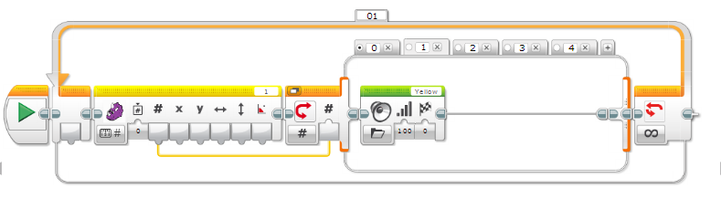
Challenge Solution
Click on the “+” to create 4 choices/”cases”
in the switch block
Use a data wire to connect the Signature Output (#) value to the Switch block which is in numeric mode
“0” will have no contents. Nothing will play if the PixyCam doesn’t recognize the object
“1”, “2”, “3” & “4” each have a sound block that will play Yellow, Green, Red and Blue sounds for its respective signature

Slide 6
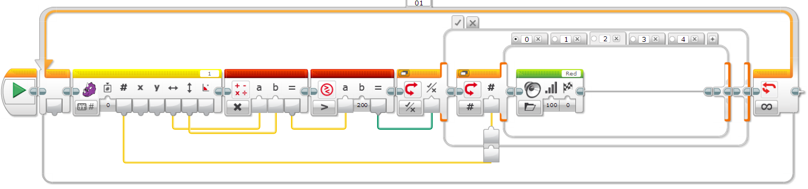
Detecting Too Many Colors?
If there are distractions in the background or foreground, you might get false positives
  Try recreating and tuning your signatures more for better results.
  Add code so that the robot does not recognize smaller items of the same color in the background.
Multiply together the width and height of the object by taking the output (dimensions) from the PixyCam block and putting them in a Math Block.
Take the result and put them into a Compare block. If the result is greater than “200”, it will be true. You have to use trial and error to get this “magic” number. (One trick it to hit play on your code in the software and look at the data going through the wire to get an idea for dimensions that would work as a threshold/minimum.)
We have a Switch Block inside a Switch Block. The sounds will play only when the outer switch is True which means that the object meets the dimension requirements we specified.

Slide 7
CREDITS
This tutorial was created by Sanjay Seshan and Arvind Seshan from Droids Robotics.
More lessons are available at www.ev3lessons.com
Author’s Email: team@droidsrobotics.org
Thank you to Marc-André Bazergui for loaning us the PixyCam for this lesson, (https://www.facebook.com/marc.a.bazergui, info@bazmarc.ca)
This work is licensed under a Creative Commons Attribution-NonCommercial-ShareAlike 4.0 International License.

