Slide 1
Identifying a Problem
By Not the Droids YOU ARE LOOKING FOR

Slide 2
About Us
  Not the Droids You Are Looking For is a 7th year team from Pittsburgh, PA
  Our research project for Trash Trek was a Global Innovation Award semi-finalist project (Top 20 out of 29,0000 teams).
  Our research project in Nature’s Fury won Innovative Solution at the FIRST LEGO League International Open in Toronto.
  Our research project for World Class was EV3Lessons.com! ;-)

Slide 3
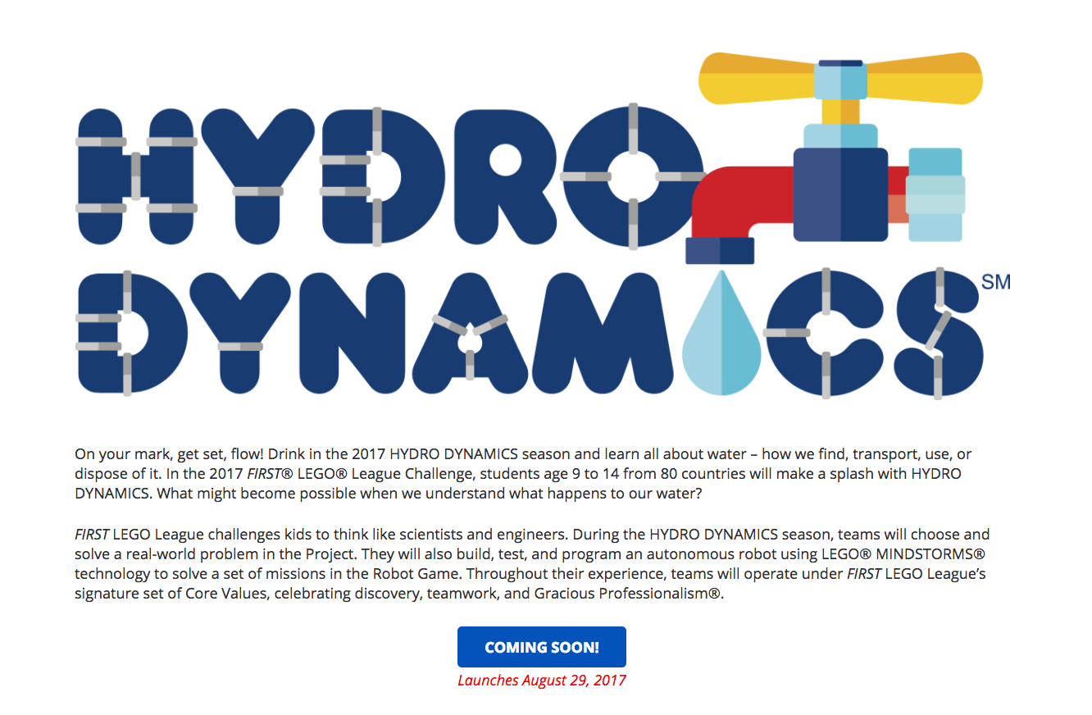
Getting an Early Start
Usually, FIRST LEGO League releases the theme for the following year around December of the previous competition season
FIRST also releases a video teaser on their YouTube channel
You can start thinking about the high-level topic pretty early.
Image Credit: CV Robotics

Slide 4
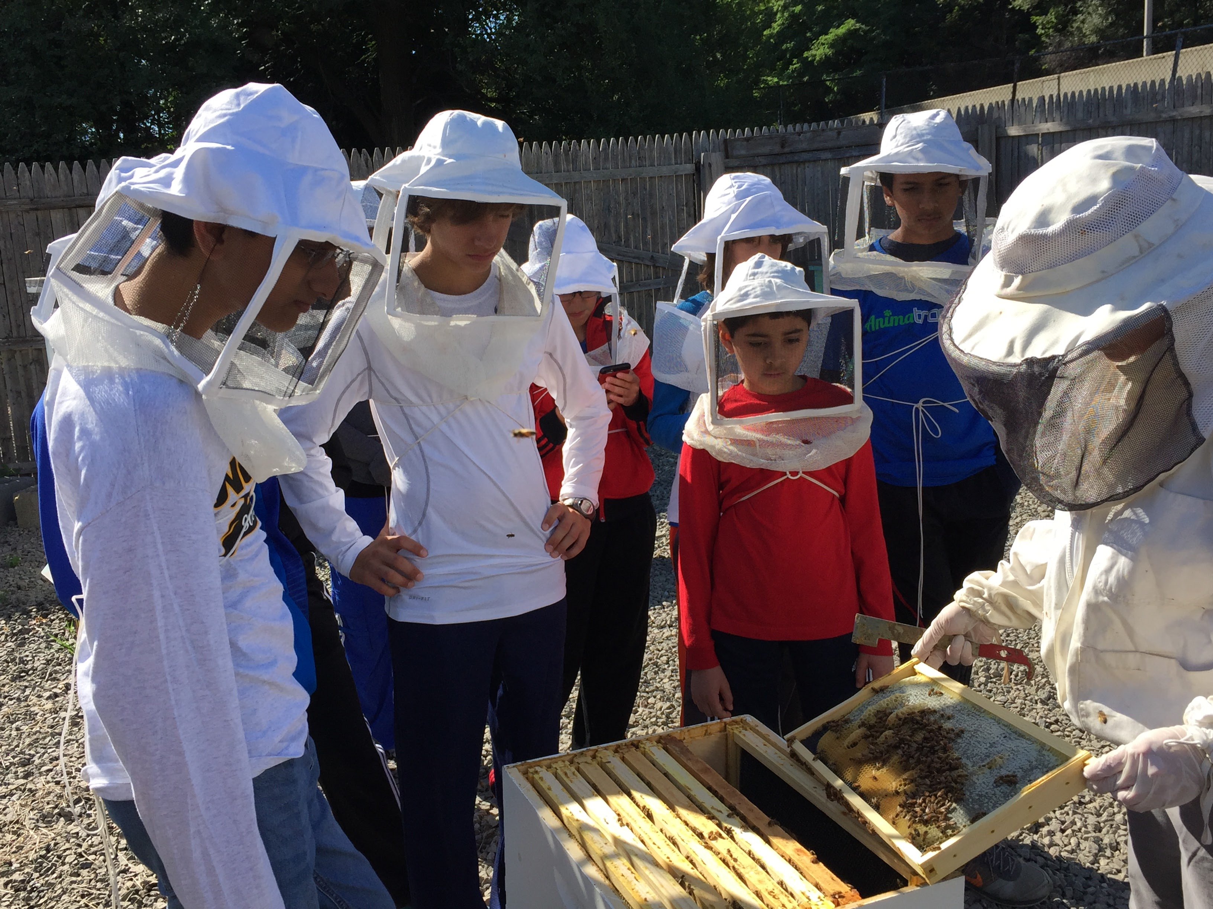
Head Start Ideas
Go on some early field trips to inspire project topics
  In Animal Allies, many teams visited Zoos and Aquariums over the summer
Do some preliminary online research related to the topic
Your goal is not to finish your project, but get some general ideas for possible topics related to the theme.

Slide 5
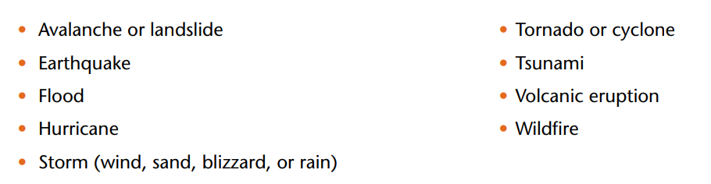
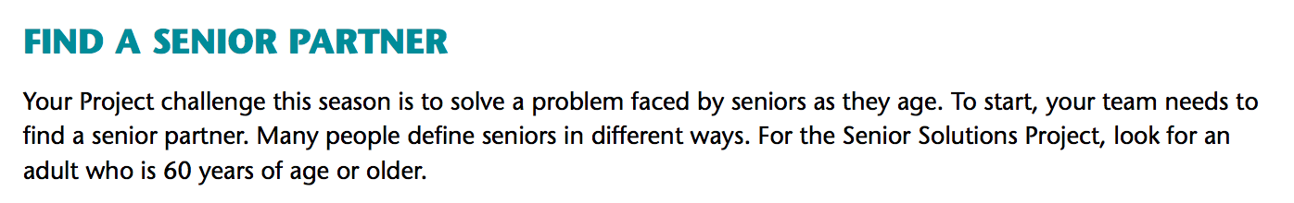
Read the Challenge Documents Carefully
Sometimes, you are allowed to pick only from a certain sub-set of topics (e.g. Nature’s Fury listed which natural disasters were allowed)
Sometimes, it calls for something specific (e.g. Senior Solutions required a Senior Partner for every team)

Slide 6
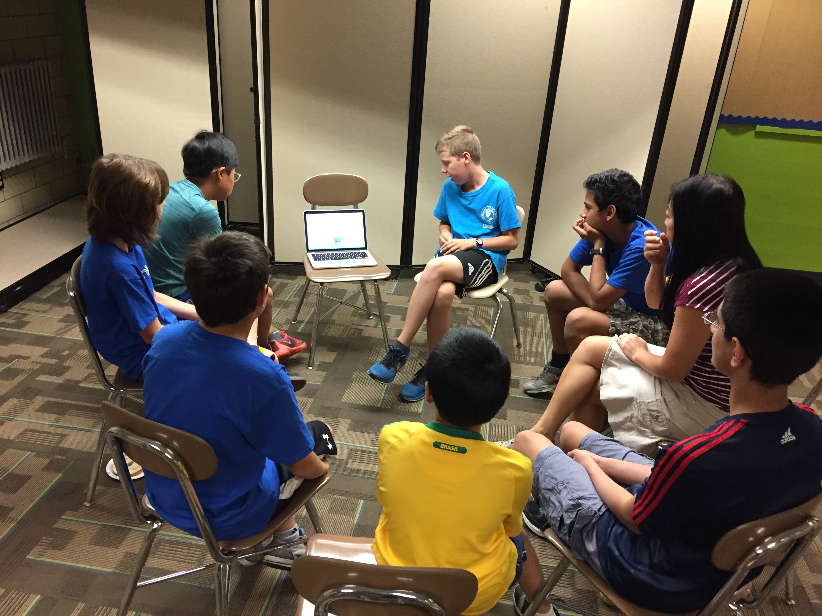
Pick a Topic Everyone Agrees Upon
Everyone works on the project
  Pick a topic that all team members can agree on/are interested in
One idea is to have all team members do a little bit of research on their favorite topic and then present this topic to each other.
  Then the team decides which topic they are most interested in to pick for their team’s project.
  Next, the team identifies a specific problem within this topic

Slide 7
“Identifying a Problem” Process
Select an Animal
Identify the Human Interaction
Problem Selected
Dolphins
Bats are killed by by wind turbines humans make
How to reduce bat deaths caused by wind turbines
K-9
Bats
Bats are killed by White Nose Syndrome which humans can spread
Bats
Sample based on team that participated in FIRST LEGO League Animal Allies

Slide 8
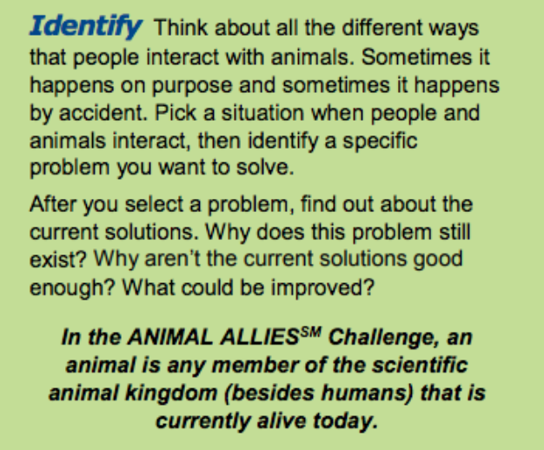
Sample Topics in Animal Allies
  Chimney Swifts losing their homes
  Training therapy dogs
  K-9 dogs helping the police
  Monitoring bee hives to keep them healthy
  Bears getting into trash cans
  Finding lost dogs
  Preventing Lyme disease from deer ticks
  Helping baby turtles find their way to the ocean
  Cow tagging
  Animals drinking from polluted city water
  Keeping horses hydrated (Global Innovation award winner 2017)
Sample topics from teams that participated in FIRST LEGO League Animal Allies

Slide 9

Credits
This lesson was written by Sanjay and Arvind Seshan
More lessons available at www.ev3lessons.com

