Slide 1
Developing an Innovative Solution
By Team 3659 NeXt Gen &
Team Phoenix

Slide 2
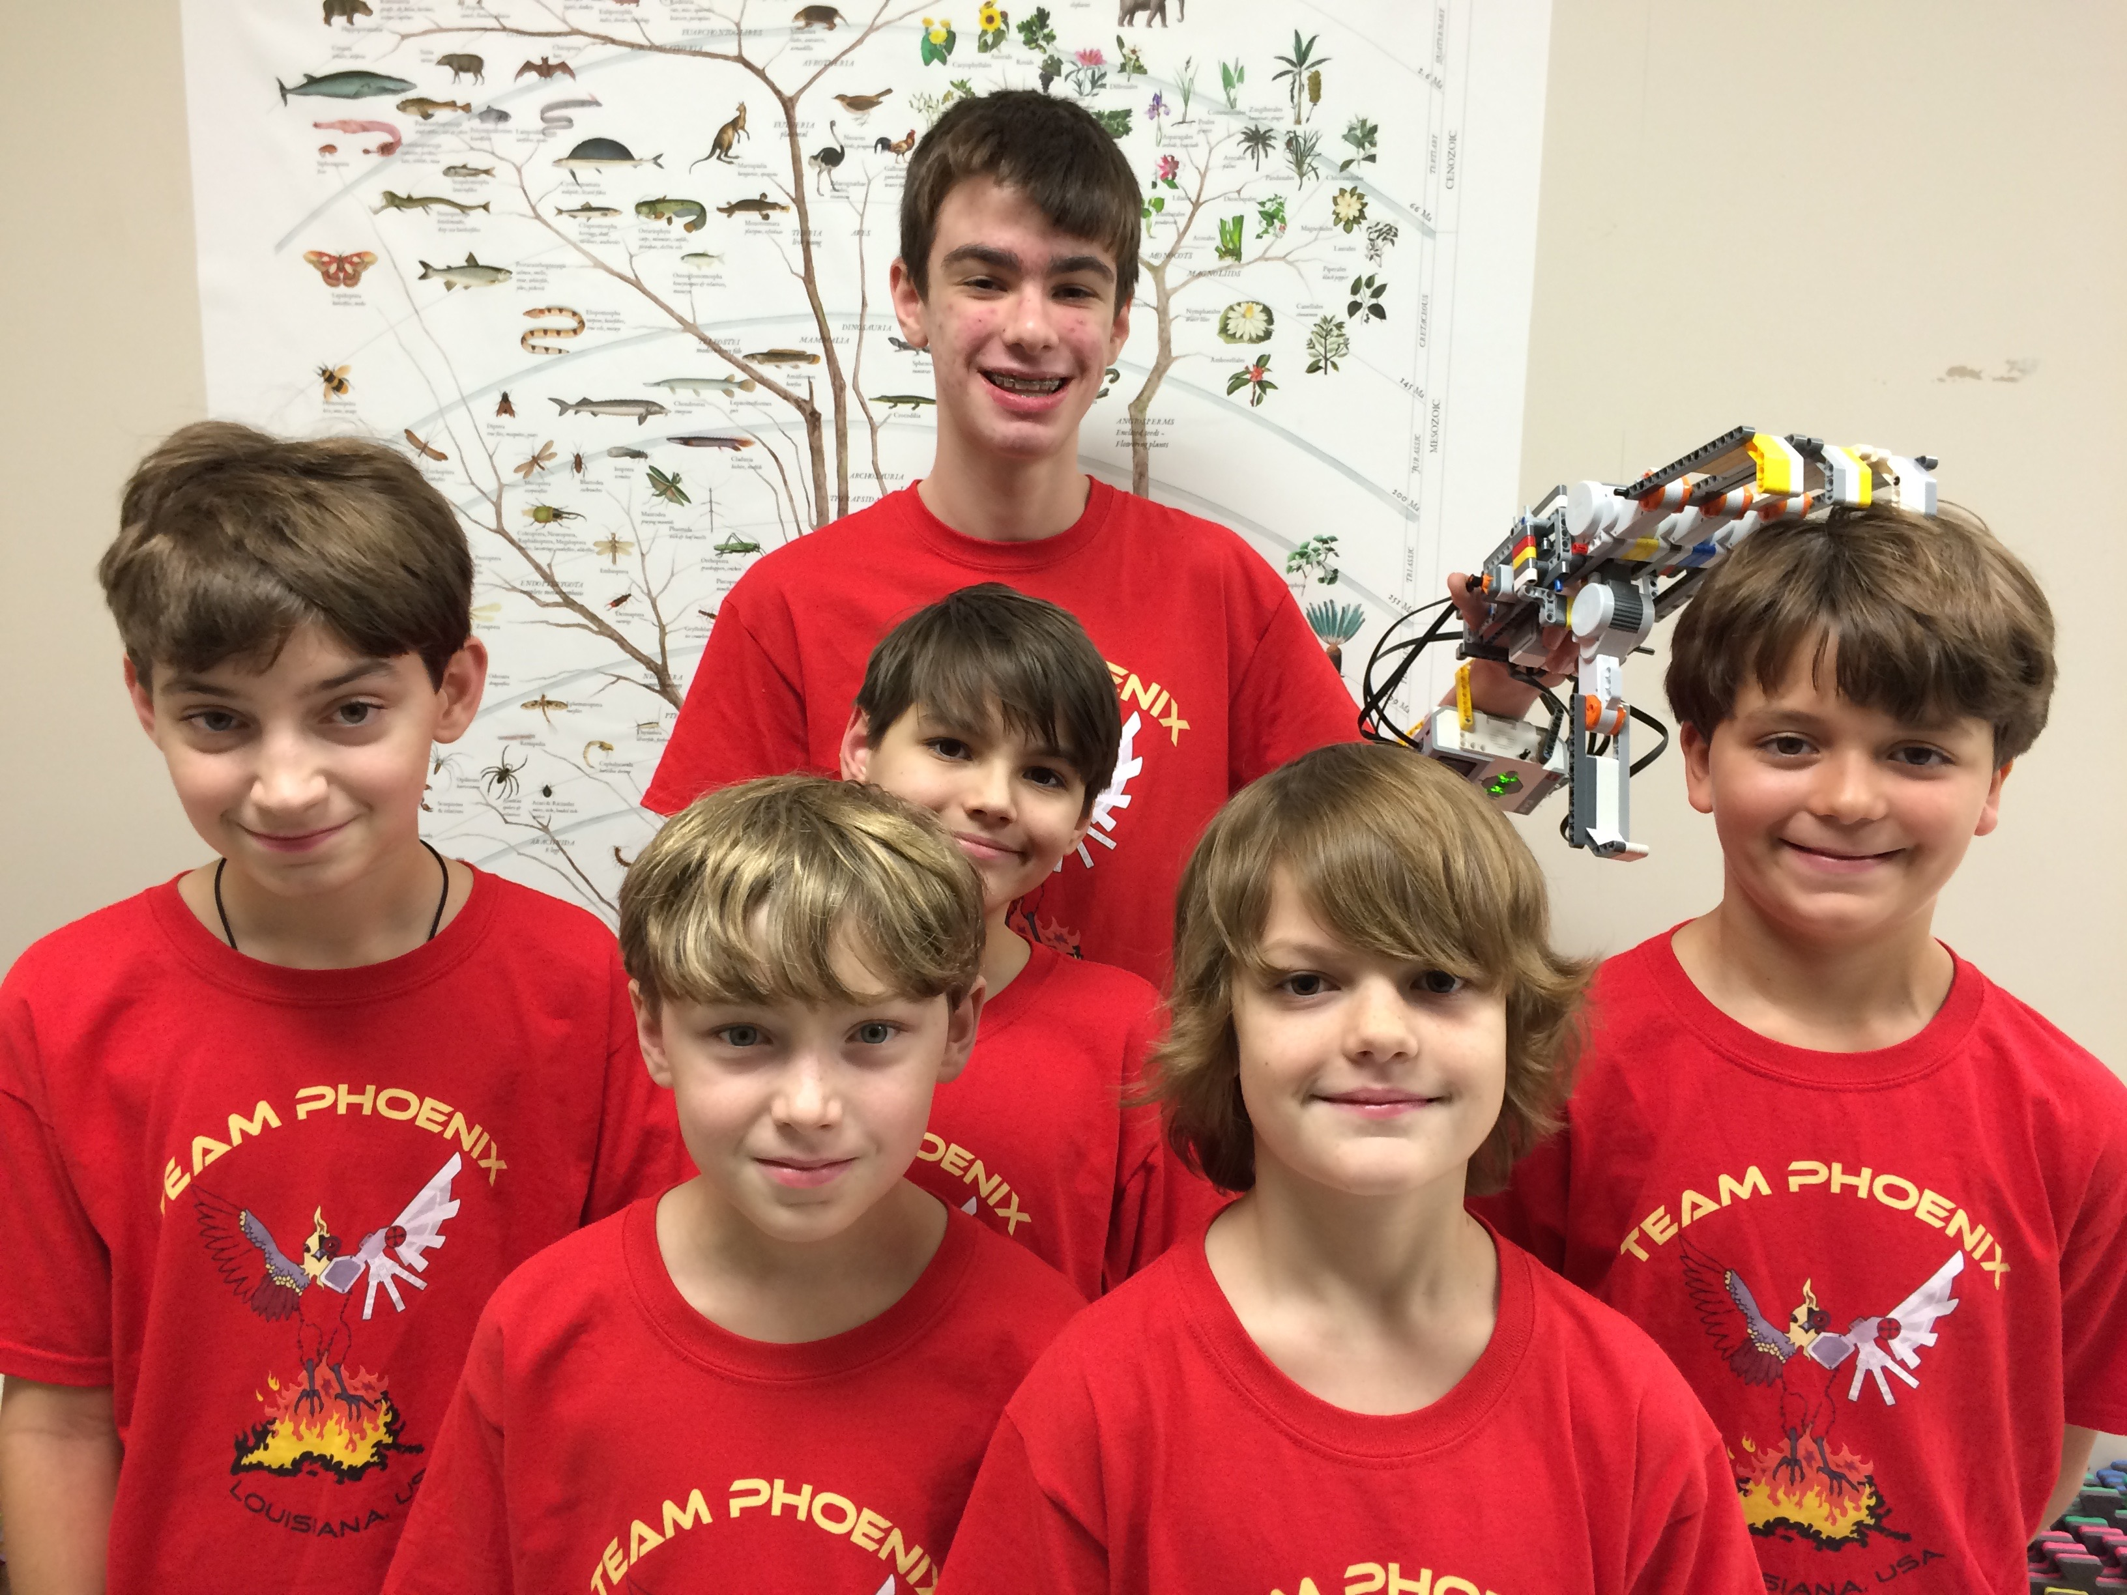
About Us
Team Phoenix, an FLL team based in Lafayette, Louisiana.
They have attended several International competitions, and placed runner-up at the Global Innovation Award 2017, in Washington D.C.
They also love inventing, having fun, and reaching out to our community.
You can learn more at https://www.fish3d.biz/
NeXT GEN is a 13th year middle school team from Garrett County, Maryland
We won first place 2013 Global Innovation Award (GIA) for the Gramma Jamma
We were on one of top 20 GIA Semi-Finalist in 2017 for innovative solution, BeeHaven
Most recently, we also won first place Innovative Solution at Mountain State Invitational in 2017

Slide 3
First Steps
So, you’ve found your topic, and now everyone's saying “Now what?” Well, this is where you apply design thinking to the situation.
Design thinking a process for creative problem solving. We follow the process developed at the Stanford d.School.
Shared by: Team Phoenix

Slide 4
Empathize
Empathize - Define - Ideate - Prototype - Test
To create meaningful innovations, you need to know your users and care about their lives.
How to Empathize
Learn all you can about your user
Watch users in their lives
Talk to them
Shared by: Team Phoenix

Slide 5
Define
Empathize - Define - Ideate - Prototype - Test
Framing the right problem is the only way to create the right solution.
How to Define
Based on empathizing, what stood out for you?
Write clear statement of the problem you will try to solve.
Share by: Team Phoenix

Slide 6
Ideate
Empathize - Define - Ideate - Prototype - Test
It’s not about coming up with the ‘right’ idea, it’s about generating the broadest range of possibilities.
How to Ideate
Go for quantity of ideas
Do not reject any ideas
Helpful Videos
How not to brainstorm!
Brainstorming Rules
Shared by: Team Phoenix

Slide 7
Prototype
Empathize - Define - Ideate - Prototype - Test
Build to think and test to learn
How to Prototype
Start building right away
Build with simple materials like cardboard
Helpful Video
How to make a cardboard prototype
Shared by: Team Phoenix

Slide 8
Test
Empathize - Define - Ideate - Prototype - Test
Testing is an opportunity to learn about your solution and your user.
How to Test
Have people try out your prototype
Shared by: Team Phoenix

Slide 9
The Process
Existing Solutions
Improvements
Develop Ideas
Be very thorough when searching via the Internet.
Tip: Think of different ways to word the solution so you will find all relevant solutions.
For example, for our project, the BeeHaven, we researched “bee hive covers”, “hive protectors”, “bee hive ventilation”, “hive wraps”, etc.
Think about a solution that will improve upon those existing solutions and solve the problem more efficiently or more effectively.
Tip: In FIRST LEGO League, Innovative Solutions do not have to be completely new. They can improve upon an existing solution.
At each meeting and/or via Google Drive, share ideas as a team to develop a strong solution.
As the team develops the solution, go back and research to see if the solution already exists.
Shared by: NeXT GEN and Not the Droids You Are Looking For

Slide 10
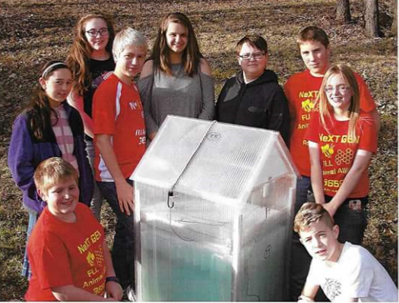
What is the Innovation?
If your particular solution/improvement does not already exist, you are ready for the next step.
Innovation
List at least three things that make the solution innovative.
In other words, what makes the team’s solution their solution? What makes the solution better than the other existing solutions?
Example: Your innovation might be cheaper, easier to make, offer more features than an existing solution.

Slide 11
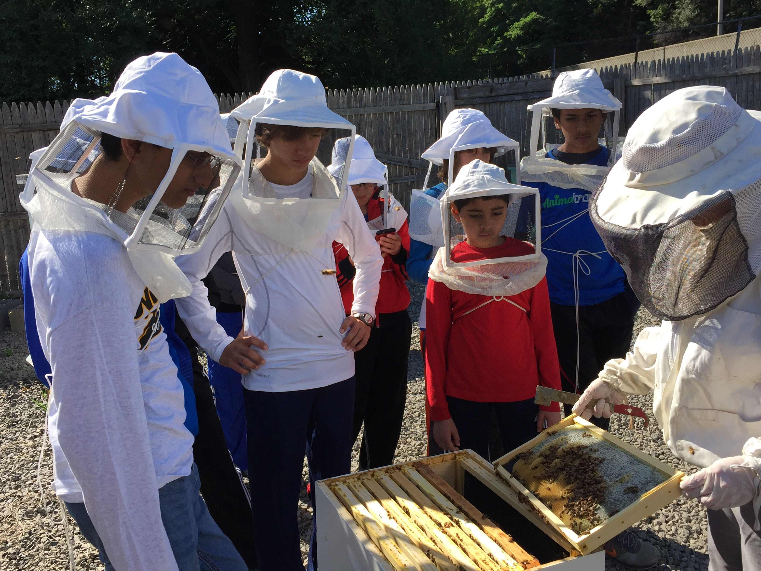
Model, Share, Test
Model
Share/Test
Prototypes are not required in FIRST LEGO League. However, a model of some kind can be helpful. Some teams make models out of LEGO/Cardboard. Some teams provide a drawing. Depending upon the project, some teams are able to develop working prototypes.
If you have a solution that can be tested, it would be a good idea to do so.
If you cannot test the solution, consider sharing your solution with an expert who can tell you if the solution would work.
Example: It would be very difficult for us to test our Nature’s Fury project in an airplane flying though a volcano. Instead, we asked professionals in the airline and sensor industries to evaluate our idea.
Shared by: NeXT GEN and Not the Droids You Are Looking For

Slide 12
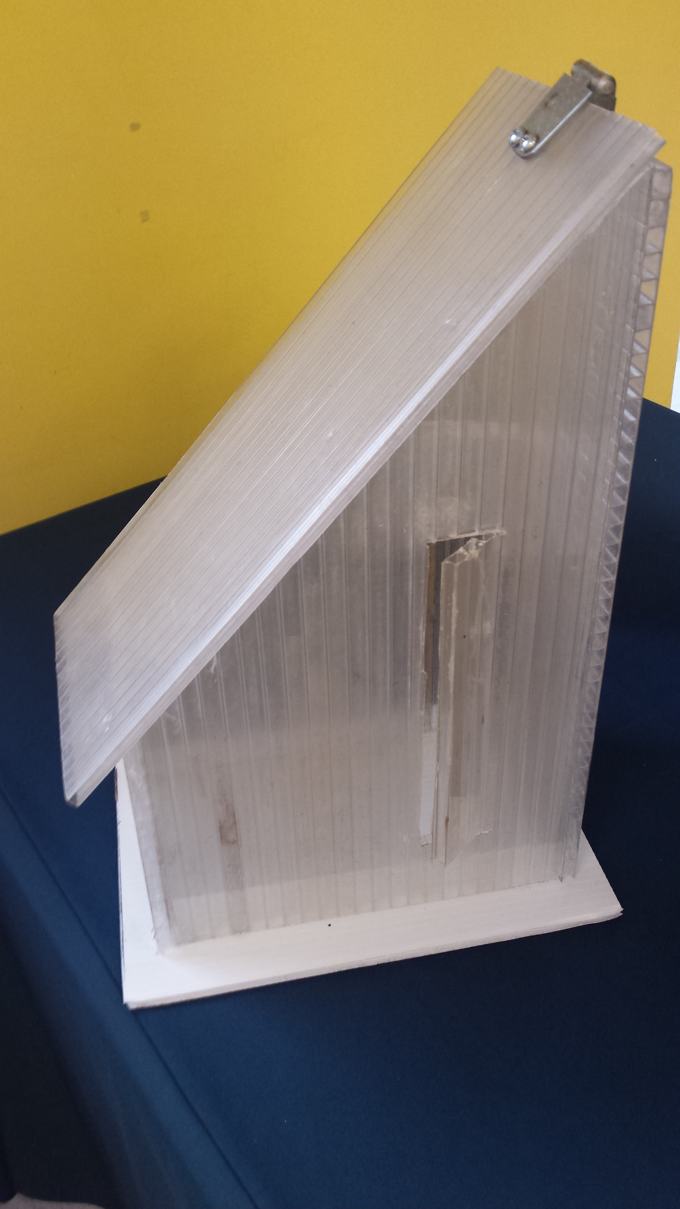
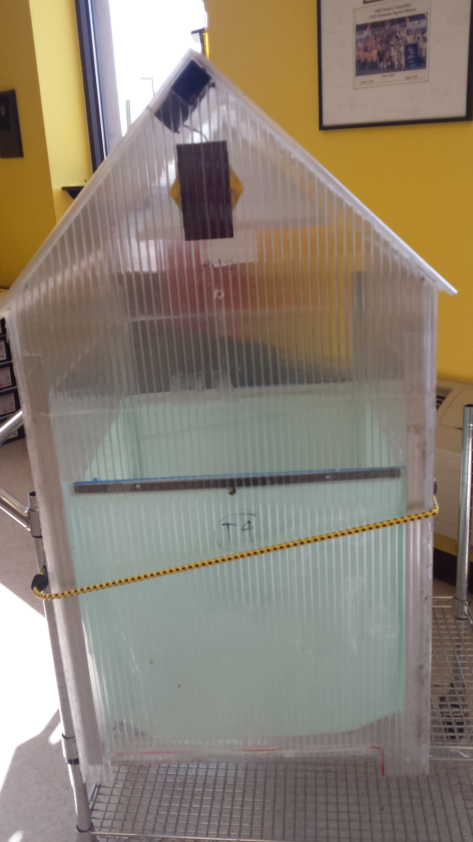
Models and Prototypes Can Help Improve Your Solution
Make a prototype of the solution if possible. It doesn’t need to be full scale.
Present the solution and the prototype to experts and receive feedback about what to improve.
Discuss as a team the feedback the experts gave. Research their suggestions.
Discuss how to implement their feedback and why implementing their feedback makes the solution better.
Implement the expert’s feedback by creating a new prototype. Go back and share your new version if possible.
Shared by: NeXT GEN

Slide 13
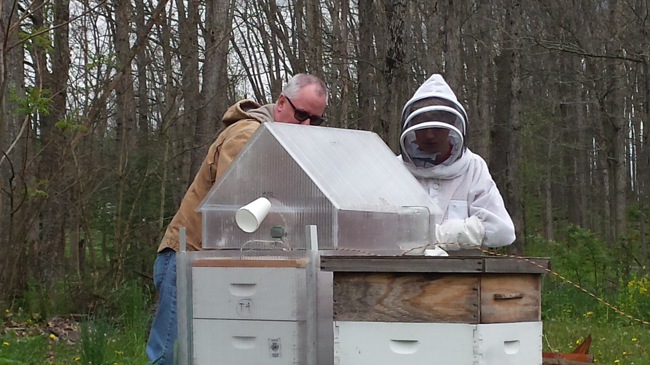
Testing Your Innovative Solution
If you are able to make a working prototype, it is a good idea to test your innovative solution
If the team notices that the solution isn’t working, discuss why it’s not working. Discuss what can be improved to make the solution work.
Make the improvements to the prototype and document the changes.
Test the solution again. If it works, discuss why it works.
Example: We logged our testing data on a website that records live data from sensors placed in various locations within a beehive. You can look at our testing data at http://Welserver.com/WEL1003
Shared by: NeXT GEN

Slide 14
Credits
This lesson was written by Team 3659 NeXT GEN and Team Phoenix, with input from Not the Droids You Are Looking For.
You can contact the teams through their Facebook pages: NeXT GEN : https://www.facebook.com/NeXTGEN3659 Team Phoenix: https://www.facebook.com/PhoenixFLL/
More lessons available at www.ev3lesssons.com

