Slide 1
Research Project Overview
By Not the Droids YOU ARE LOOKING FOR

Slide 2
About Us
Not the Droids You Are Looking For is a 7th year team from Pittsburgh, PA
Our research project for Trash Trek was a Global Innovation Award semi-finalist project (Top 20 out of 29,0000 teams).
Our research project in Nature’s Fury won Innovative Solution at the FIRST LEGO League International Open in Toronto.
Our research project for World Class was EV3Lessons.com! ;-)

Slide 3
What is the Research Project?
A group research project related to the year’s theme
Come up with an innovative solution to a real-world problem
Themes:
2011: Food Factor (food safety)
2012: Senior Solutions (senior citizens)
2013: Nature’s Fury (natural disasters)
2014: World Class (education)
2015: Trash Trek (garbage)
2016: Animal Allies (animals)
2017: Hydro Dynamics (water)

Slide 4
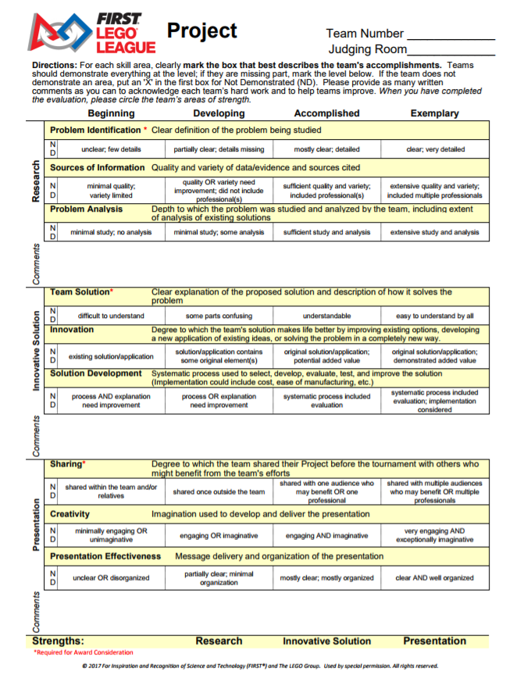
New Rubrics for 2017
Research
Identify a problem and analyze existing solutions
Innovative Solution
Develop a solution to your problem and understand what it would take to implement this idea.
Presentation
Share your project with people/organizations
Create an effective presentation for judges

Slide 5
Project Process
Identify a Problem
Background Research
Innovative Solution
Test Idea
Sharing/
Presentation
Research
Innovative Solution
Sharing
Look for lessons on each of these topics on EV3Lessons.com

Slide 6
SAMPLE PROJECTS
2011: Food Factor (food safety)
Detecting spoilt milk
2012: Senior Solutions (senior citizens)
Helping seniors remember where they left their pocessions
2013: Nature’s Fury (natural disasters)
An early-warning ash detection system for airplanes
2014: World Class (education)
A better way to learn to program the EV3 (EV3Lessons.com)
2015: Trash Trek (garbage)
A more efficient way to recycle batteries (InvisiSort)
2016: Animal Allies (animals)
Bats getting killed by wind turbines

Slide 7
Credits
This lesson was written by Sanjay and Arvind Seshan
More lessons available at www.ev3lessons.com

