Slide 1
Colour Sensor
By Sanjay and Arvind Seshan

Slide 2
Lesson Objectives
Learn how to use the Colour Sensor
Learn about Coast and Brake

Slide 3
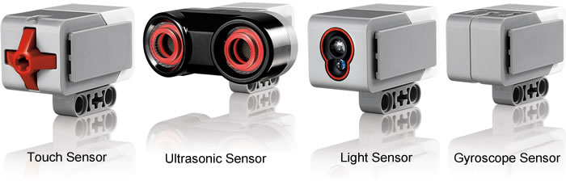
What is a sensor?
A sensor lets an EV3 program measure and collect data about is surroundings
The EV3 sensors include:
  Colour – measures color and darkness
  Gyro – measures rotation of robot
  Ultrasonic – measures distance to nearby surfaces
  Touch – measures contact with surface
  Infrared – measures IR remote’s signals
Image from: http://www.ucalgary.ca/IOSTEM/files/IOSTEM/media_crop/44/public/sensors.jpg

Slide 4
What is the Colour Sensor?
What are they? Sensors that detect the intensity of light that enters it
Three modes: Colour, Reflected Light Intensity and Ambient Light Intensity
  Color Mode: Recognizes 7 colours (black, brown, blue, green, yellow, red, white) and No Color
  Reflected Light: Measures the intensity of the light reflected back from a lamp that emits a red light. (0=very dark and 100=very light)
  Ambient Light: Measures the strength of the light that enters the sensor from the environment. (0=very dark and 100=very light)
USES:
  Move until a line
  Follow a line
We will use COLOR MODE in this Lesson

Slide 5
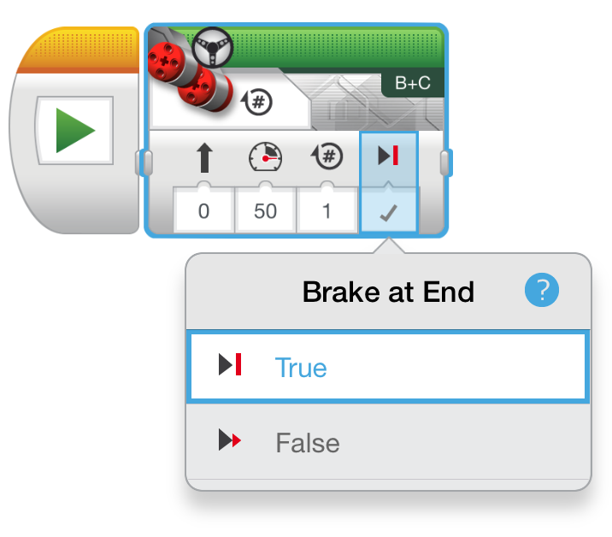
Another Move Steering Tip: Coast or Break?
Something more about the Move Steering Block
You will notice you have an option to COAST or BRAKE
Coast will make the motors keep moving. Brake makes the motors stop immediately.
Which do you use to stop EXACTLY on a colored line?

Slide 6
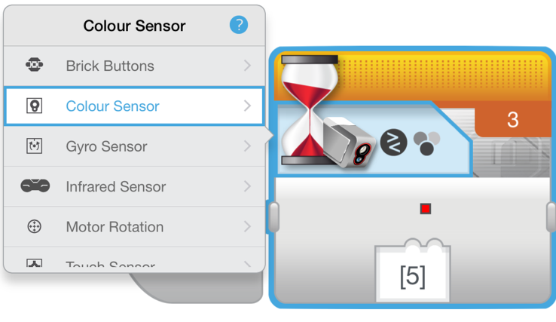
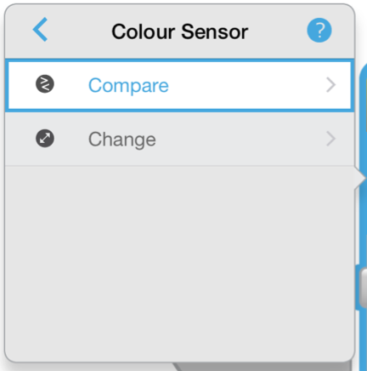
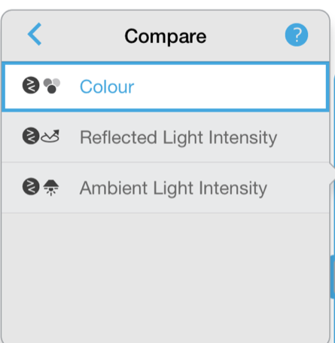
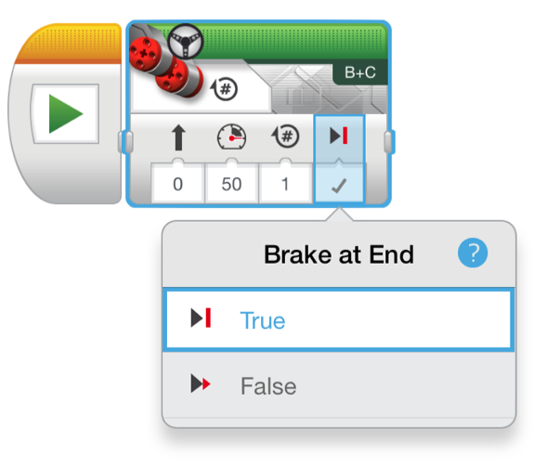
Colour Sensor Challenge
Make the robot move up to a green line using the color sensor?
Step 1: Use Wait For Colour
Step 2: Use the colour sensor in COLOR MODE
Step 3: Coast or Brake?
Hint: You will use Move Steering (think about motor on and off) and Wait for “Color”

Slide 7
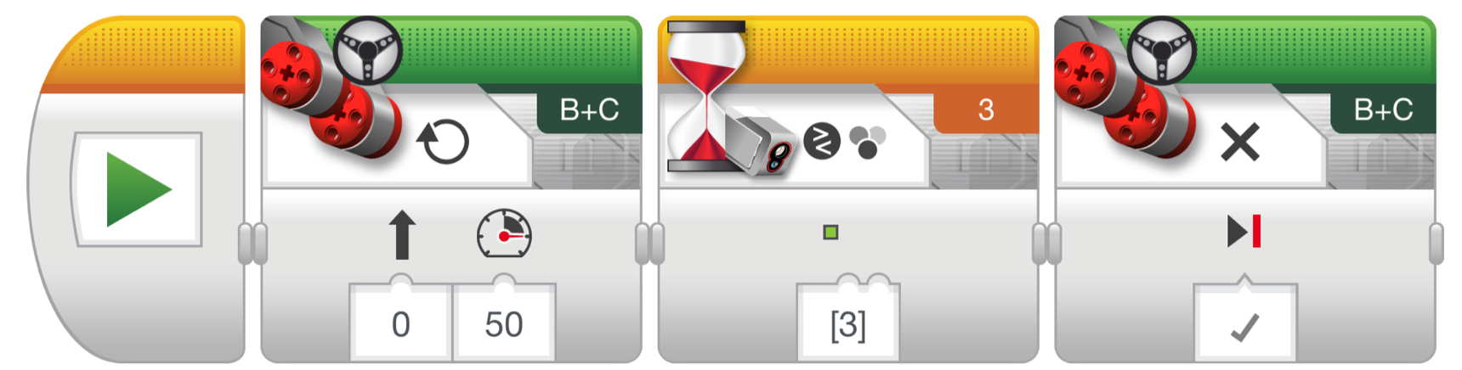
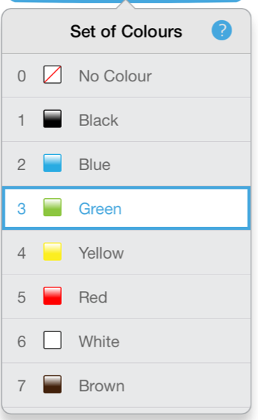
Colour Sensor Challenge Solution
FINISH
Move Steering
Set to “ON”
Move Steering
Set to “OFF” with BRAKE
START
Wait until Colour is Green (#3)

Slide 8
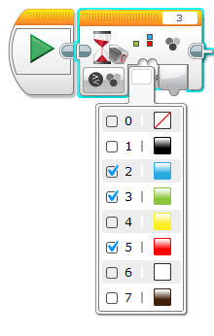
Discussion Guide
Can you look for more than one colour with the colour sensor?
What is the difference between
COAST and BRAKE in a Move Steering Block?
Answer: Yes
Ans. Coast will allow your motors to spin freely after a move, but Brake will Immediately stop it

Slide 9
CREDITS
This tutorial was created by Sanjay Seshan and Arvind Seshan
More lessons are available at www.ev3lessons.com
This work is licensed under a Creative Commons Attribution-NonCommercial-ShareAlike 4.0 International License.

