Slide 1
Display Blocks
By Sanjay and Arvind Seshan

Slide 2
Lesson Objectives
Learn to use the Display Block to display text and images
Understand why the Display Block can be useful in programming

Slide 3
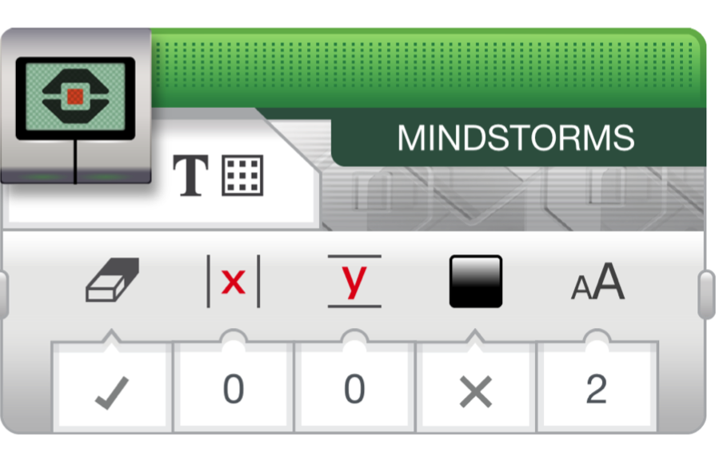

Display Block
The Display Block to show information and pictures on the screen
You can control the location and size of text
You can use this same block to display sensor readings and instructions.
Located in Green Tab

Slide 4
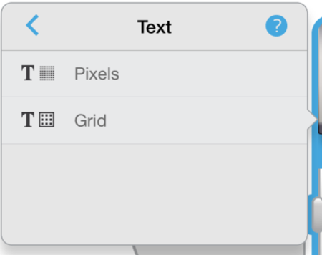
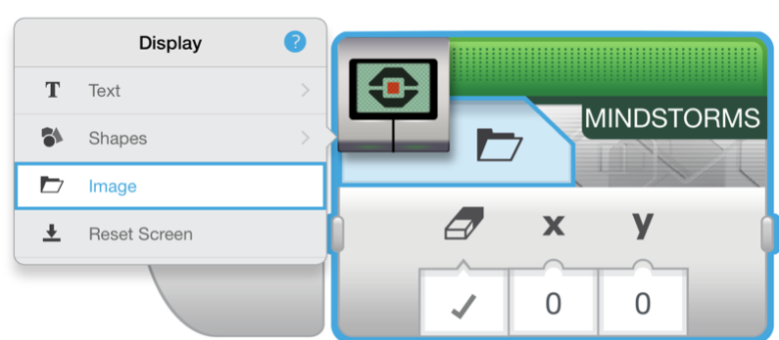
More on Display Blocks
Two modes to display
Pixel mode (Use for displaying images or text)
  178 pixels left and right
  128 pixels up and down
Grid mode (Easier to use, only works for text mode)
  22 columns of 8 pixels each
  12 rows of 10 pixels each
  Small characters are 1 row and 1 column
  Large characters are 2 rows and 2 columns

Slide 5
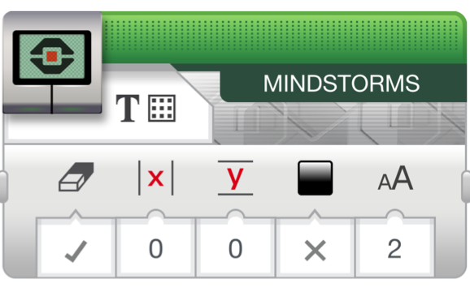
Displaying Text in Grid Mode
Step 1:
Pick Display Block
Step 2:
Click on “Switch Modes” icon and hover over “text”. Then click on “grid”. The icon will change into a square with dots.
Step 3:
Use the box on the top right to enter the text you want to display
Switch Modes
Text to be displayed
Erase Screen
Column to start display
Row to start display
Text size
0 – small font
1 – small, bold font
2 – large font
Black/White Display
Text Size

Slide 6
Display Block Challenge 1
Can you write a program to display text in the centre of the screen?
  Display “Hello World”
Make the display block run for 3 seconds
Can you also move while doing this?

Slide 7
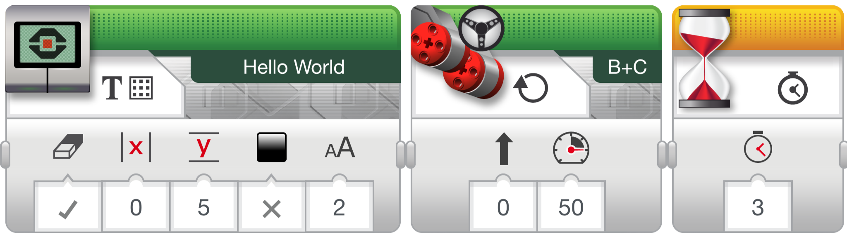
Challenge 1 Solution

Slide 8
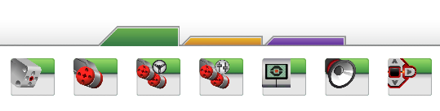
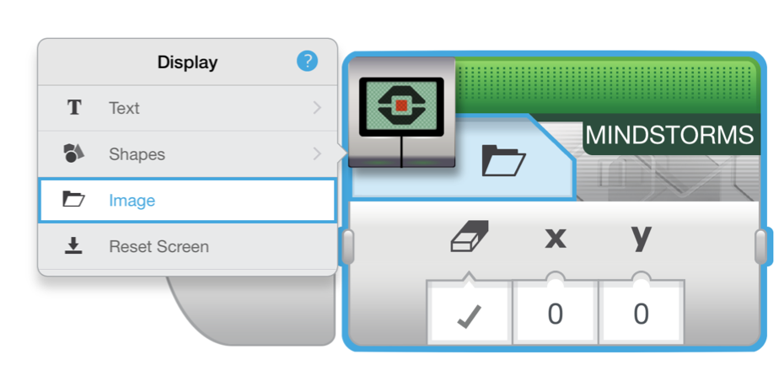
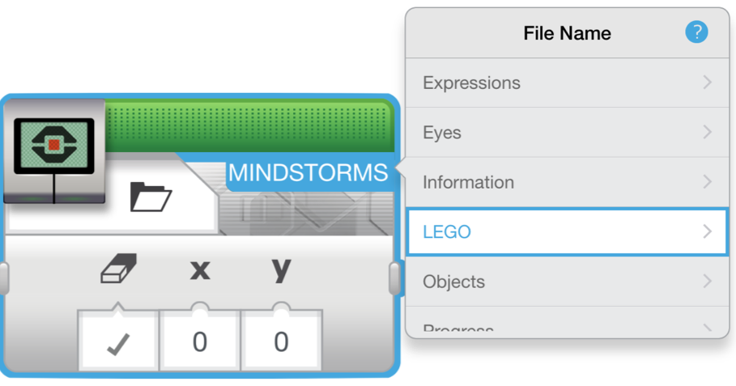
Displaying an image in PIXEL Mode
Step 1:
Pick Display Block
Step 2:
Click on the “Select Mode” which has a folder icon and pick “image”
Step 3:
Use the empty box on the top right to pick the image you want to display

Slide 9
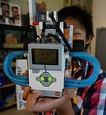
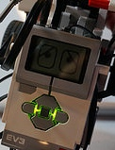
Display Block Challenge 2
Can you display eyes on the screen while moving? Alternate eyeballs that look left and right.
  Use the Display Block, Motor On and Wait Block
Feel free to have fun with this challenge and make it yours!

Slide 10
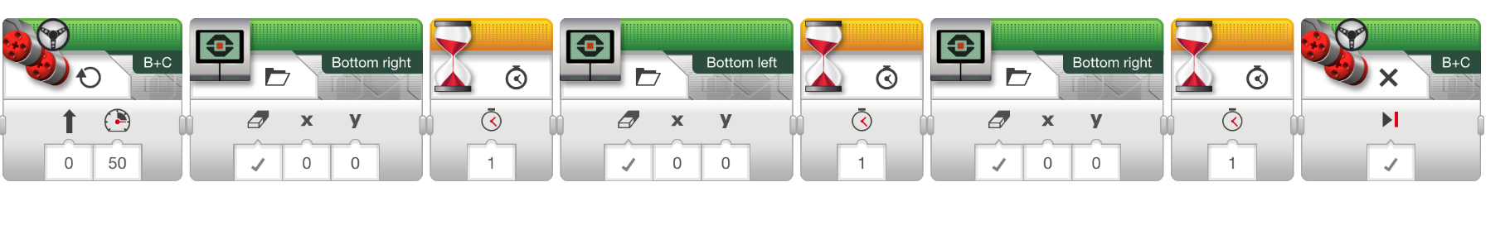
Challenge 2 Solution
Motor On
Display Block
Wait Block
Motor Off

Slide 11
Discussion Guide
Why might you want to know how to use the display block?
  You might want to know what the sensor value your robot is seeing
  You might have to program a robot to stop when the robot reaches a red line but it stops before
    Does the robot see the same thing you see?
    You can display the value on the screen and check
It’s a great debugging tool. You can learn more about debugging code in one of our Intermediate lessons.

Slide 12
Credits
This tutorial was created by Sanjay Seshan and Arvind Seshan
More lessons are available at www.ev3lessons.com
This work is licensed under a Creative Commons Attribution-NonCommercial-ShareAlike 4.0 International License.

