Slide 1
Touch sensor
By Sanjay and Arvind Seshan

Slide 2
Lesson Objectives
Learn how to use the Touch Sensor
Learn how to use the Wait For Block
Learn the difference between the Wait For Block and the Sensor Blocks
Learn when to use Move Block’s “On” mode

Slide 3
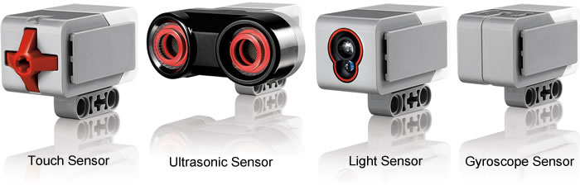
What is a Sensor?
A sensor lets an EV3 program measure and collect data about is surroundings
The EV3 sensors include:
  Colour – measures color and darkness
  Gyro – measures rotation of robot
  Ultrasonic – measures distance to nearby surfaces
  Touch – measures contact with surface
  Infrared – measures IR remote’s signals
Image from: http://www.ucalgary.ca/IOSTEM/files/IOSTEM/media_crop/44/public/sensors.jpg

Slide 4
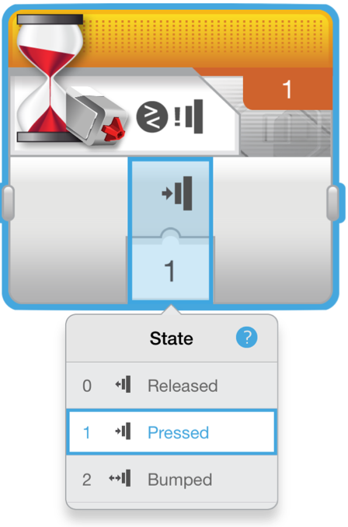
What is a Touch Sensor?
Touch Sensor can detect when the sensor’s red button has been pressed or released
With this information, you can program an action when the sensor is:
Currently Pressed
Currently Released
Pressed and Released Just Before (Bumped)
When might you use this sensor?
  Useful for programming “moving until touch sensor is pressed/released/bumped”
  For example, if you put a touch sensor on the front the robot, you can have it stop moving if it runs into something.
  You can also have your program start or stop when a touch sensor is pressed.

Slide 5
What Does “Bumped” Mean?*
The sensor basically is like a True/False switch
“Bumped” can be tricky. What conditions must be there for the sensor to read True for Bumped?
Time | Action | Pressed | Released | Bumped
1 | Button starts released | False | True | False
2 | Button is pressed in | True | False | False
3 | Button is released, and program reads sensor | False | True | True
4 | Button is still released, and the program tests the Touch Sensor again | False | True | False
5 | Button is pressed a second time | True | False | False
6 | Button is released, but the program does not read the sensor
200 secs later… | Program reads sensor | False | True | True
201 | Button is still released, and the program tests the Touch Sensor again | False | True | False
* Based on the Lego EV3 help screen

Slide 6
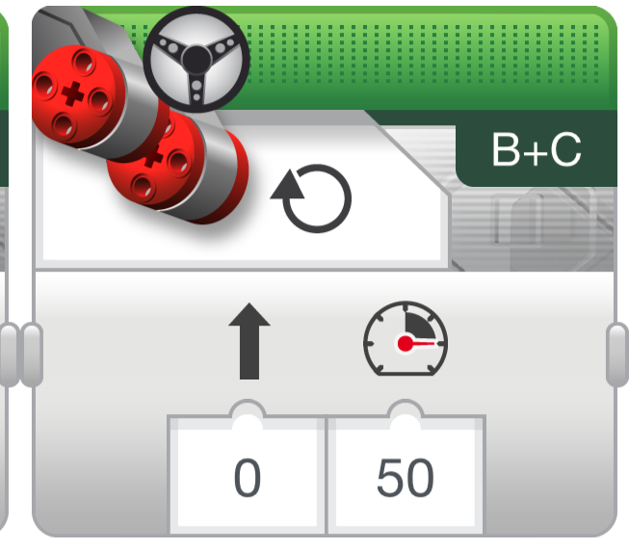
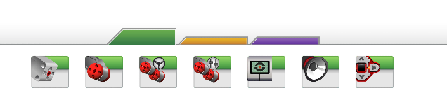
A Tip for Move Steering Blocks With Sensors
Leaving the motor “on” and “off”
Why use the “on” instead of “degrees”?
  May want the program to do other tasks such as reading a sensor while moving

Slide 7
Teacher Instructions
Challenges are on slides 9 and 11
Solutions to these challenges are on slides 10 and 12
Discussion is on slide 13

Slide 8
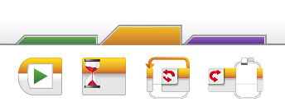
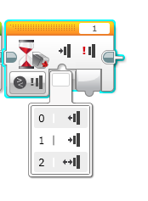

Challenge 1
Program your robot to move straight until you tap the sensor with your hand.
0 = released
1 = pressed
2 = bumped
B
Hint: You will combine: Move Steering + Wait Block
C

Slide 9
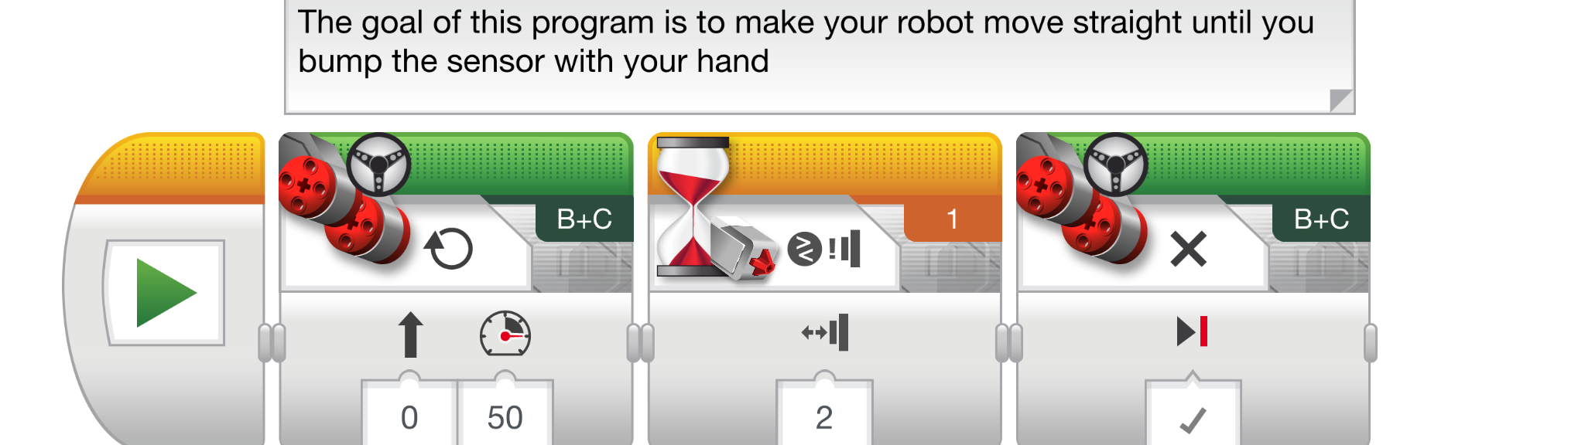
Challenge 1 Solution

Slide 10
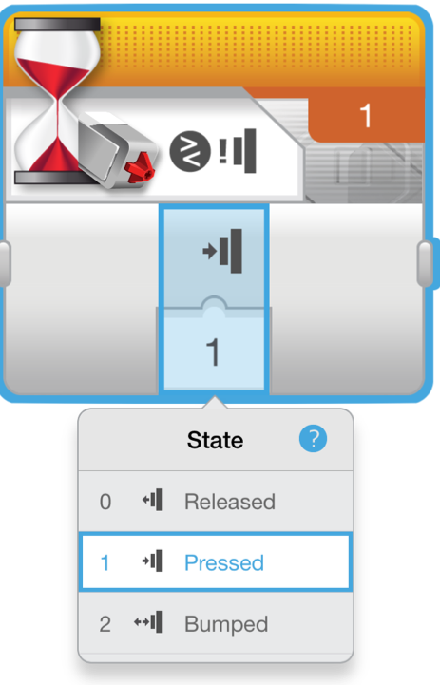
Challenge 2
Program your robot to move until it hits the wall. Then back up and turn right (90 degrees)
0 = released
1 = pressed
2 = bumped
B
C
Hint: You will combine Move Steering + Turning + Wait Block

Slide 11
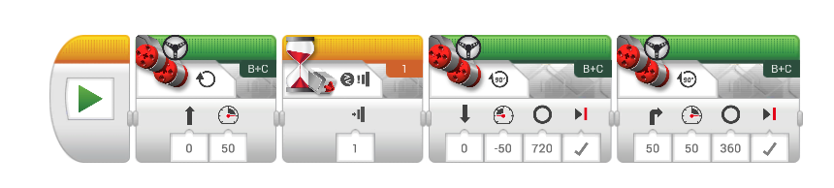
Challenge 2 Solution
Move forward until touch
The touch sensor is set to compare → state → pressed mode.
Move backwards the number of desired degrees (adjust for your robot)
Turn right. (Adjust the number of degrees for your robot)

Slide 12
DISCUSSION
Why did you use MOTOR ON for these challenges?
You want to read the sensor while the motor is on.
Why do we use the WAIT FOR BLOCK in these challenges?
We need to program to wait for the correct reading
What is the difference between PRESSED, RELEASED and BUMPED?
PRESSED = pushed in, RELEASED = not pushed,
BUMPED = pressed and released recently
What are some situations you might want to use each of these for?
PRESSED = running into a wall, BUMPED = tapped by hand
RELEASED = no longer touching a wall

Slide 13
CREDITS
This tutorial was created by Sanjay Seshan and Arvind Seshan
More lessons are available at www.ev3lessons.com
This work is licensed under a Creative Commons Attribution-NonCommercial-ShareAlike 4.0 International License.

